Slide 1

Startup Profit Prediction and Analysis
Name: S.Manoj Prabhakar
Course: CDA
Project-ID: PRDA – 01 Profit Analysis

Slide 2

Introduction
Startups invest in R&D, Marketing, and Administration.
These investments directly influence profitability.
This project analyzes startup data and predicts profit using machine learning.

Slide 3

Problem Statement
Many startups do not know which type of investment generates the highest profit.
This project analyzes spending patterns and predicts startup profit using data analysis.

Slide 4
Objective
Analyse the startup dataset
Identify factors affecting profit
Build a machine learning prediction model
Visualize insights using a dashboard

Slide 5

Dataset Description
Feature | Description
R&D Spend | Research & Development investment
Administration | Administrative expenses
Marketing Spend | Marketing investment
State | Startup location
Profit | Target variable

Slide 6

Tools
Tools and technologies:
My sql
Python
Pandas
Scikit-Learn
Power BI

Slide 7

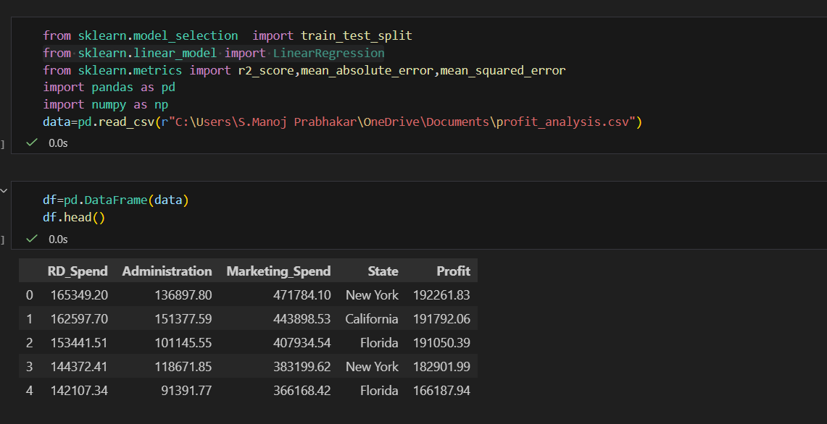
Data Preprocessing
Steps:
Loaded dataset using Python
Checked for missing values
Verified zero values in R&D and Marketing
Split data into training and testing sets
Code Snippet:

Slide 8
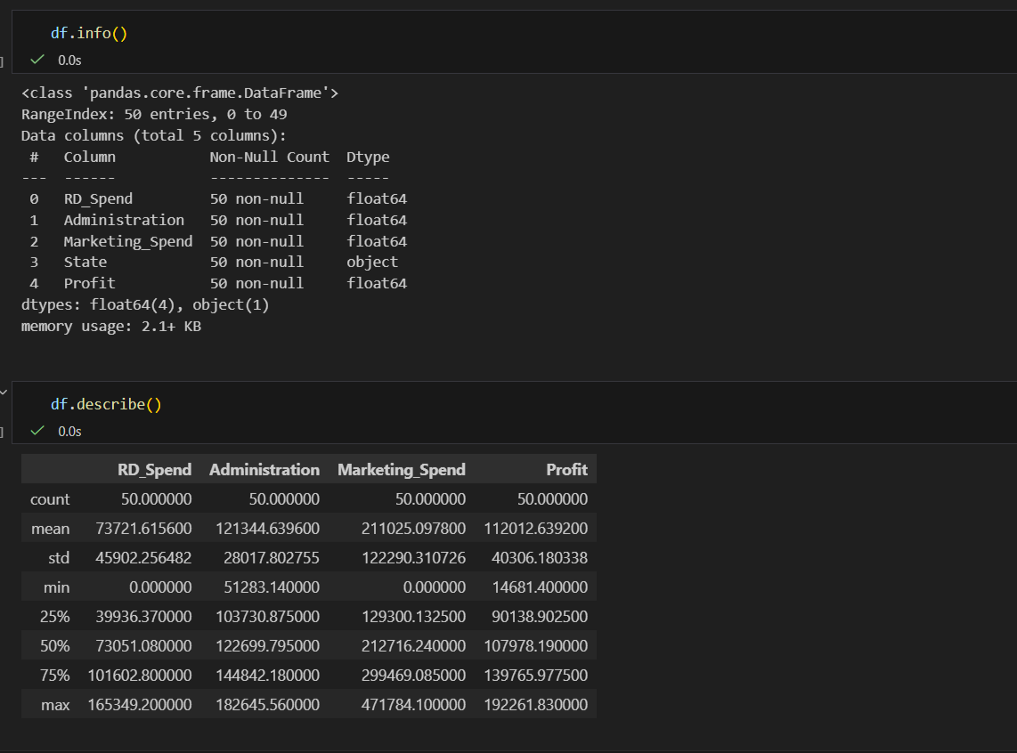
Code Snippet:

Slide 9
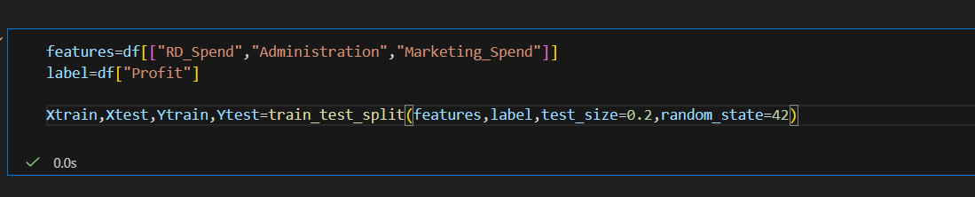
Code Snippet:

Slide 10
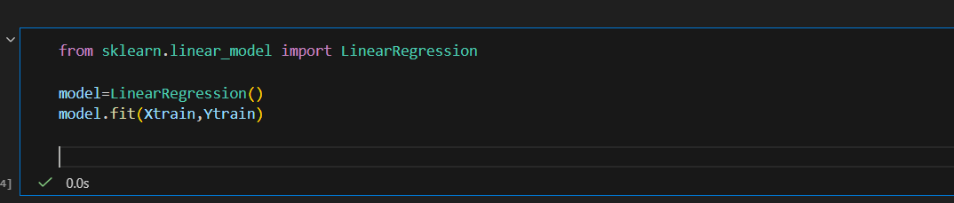
Model Building
Model Used:
Linear Regression
Code Snippet:

Slide 11
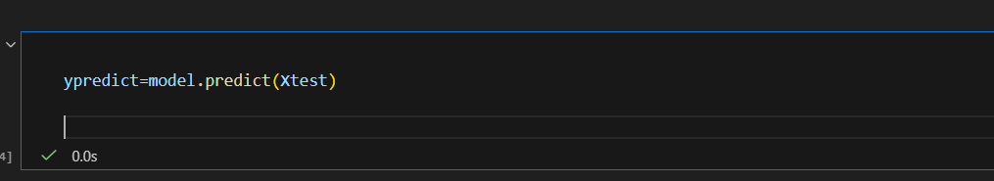
Model Prediction
Code Snippet:

Slide 12
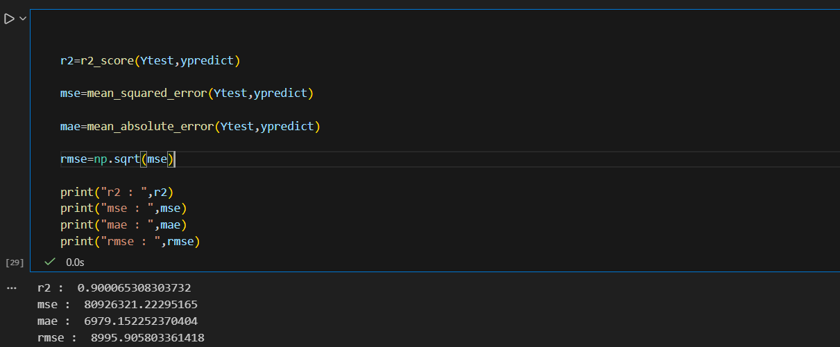
Model Evaluation
Code Snippet:

Slide 13
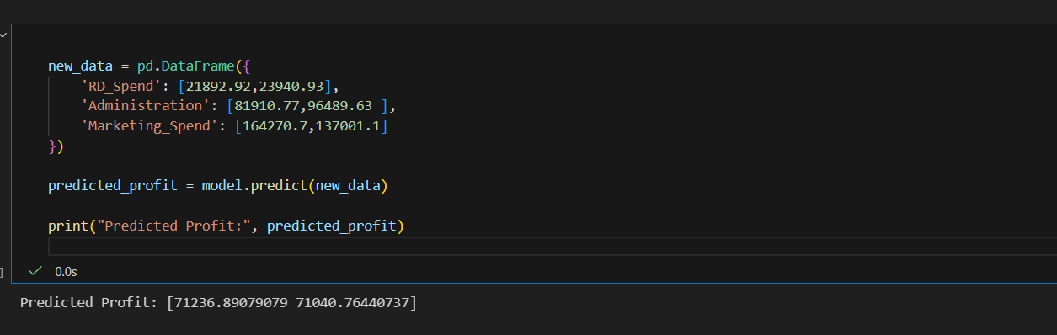
Prediction Example
Code Snippet:
RD_Spend | Administration | Marketing_Send | Profit
21892.92 | 81810.77 | 164270.7 | 71236.89
23940.93 | 96489.63 | 137001.1 | 71040.76

Slide 14
Dashboard Visualization
Visualizations include:
R&D Spend vs Profit
Marketing Spend vs Profit
Administration vs Profit
Profit by State
KPI metrics

Slide 15
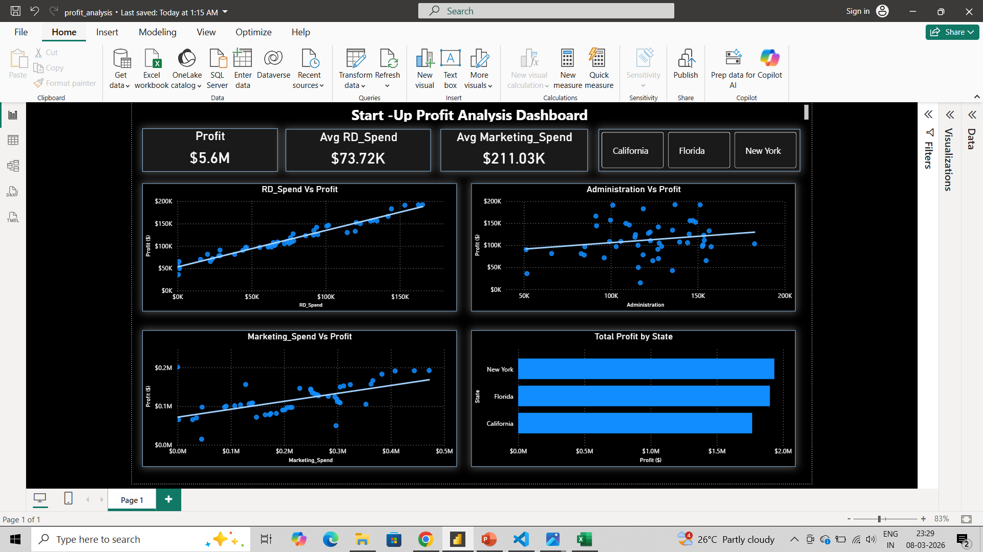
Dashboard
R&D spend has strong correlation with profit
Marketing has moderate impact
Administration has lower impact

Slide 16
Key Insights
R&D spend has the strongest impact on profit
Marketing spend has moderate influence on profit
Administration has lower impact on profit
Startups investing more in R&D tend to achieve higher profits

Slide 17
Business Recommendations
Based on the analysis, the following recommendations are suggested:
Increase investment in Research & Development to improve profitability
Improve marketing investment decisions to maximize profit.
Reduce unnecessary administration expenses
Focus investments on activities that generate higher revenue

Slide 18
Conclusion
This project demonstrates how machine learning and data analysis can help predict startup profitability.
Key findings:
R&D investment significantly impacts profitability.
Linear regression can effectively predict startup profit.
Power BI dashboards help visualize important business insights
Data-driven decisions can help startups optimize spending and maximize profit.

Slide 19

Thank You

